Slide 1
Fresh start consults - networking case study
Enhancing SOHO Network Security with a Firewall
As a follow-up to your SOHO network design:
1. Add a firewall device (use a router or a Layer 3 switch to simulate firewall functionality).
2. Configure Access Control Lists (ACLs) to:
a. Block incoming traffic from unauthorized IP addresses.
b. Allow only specific devices (e.g., the admin PC) to access the router’s settings.
3.Create a scenario where one device is blocked from accessing the internet, and another is allowed.
4.Document the steps you took and explain the reasoning behind your firewall rules.
5.Test your firewall setup using ping and web simulations.

Slide 2
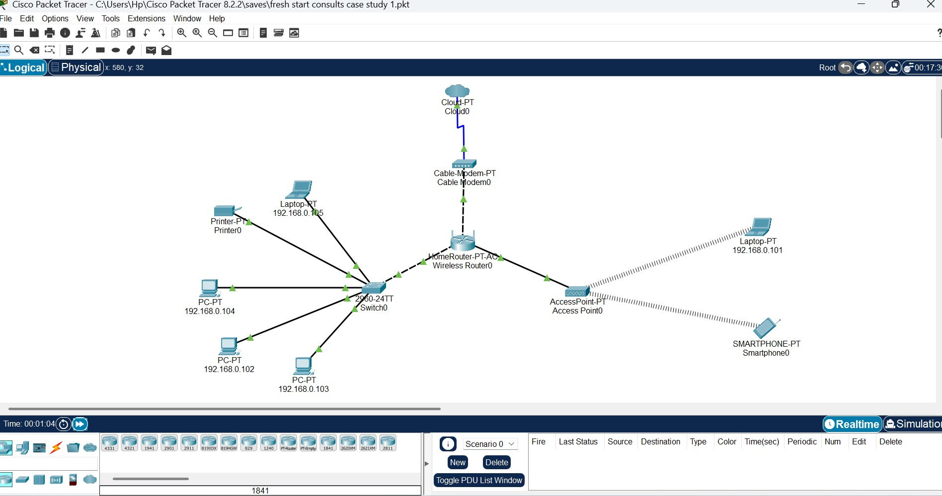
Before adding the Layer 3 switch and Ethernet router for firewall

Slide 3
Gateway -192.168.01 – with wireless Home router
PC 1- 192.168.0.102
Pc2- 192.168.0.100
Pc3- 192.168.0.104
Pc4-192.168.0.101
PC5-192.168.0.103
PC0-192.168.0.101
IP address using DHCP protocol will be changed to static with new IP addresses assigned

Slide 4
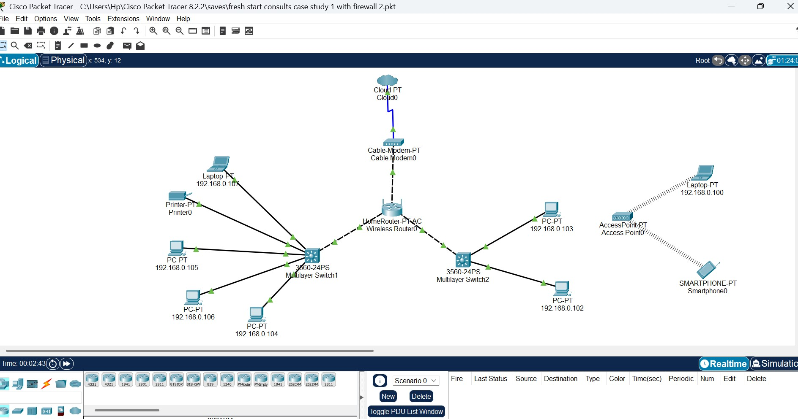
1. Added a router and 2 Layer 3 switches to simulate firewall functionality.

Slide 5
2. Configure Access Control Lists (ACLs) to: a. Block incoming traffic from unauthorized IP addresses. b. Allow only specific devices (e.g., the admin PC) to access the router’s settings Access Control Lists configuration(ACLs): Configuration for switch 1
Switch>en
Switch#conf t
Switch(Config)# host s1
S1(Config)#end
S1#Sg ip int brief
S1 Conf t (Enter)
S1 (Config)#int Vlan 1
S1 (Config-if)#no shut
S1(config-if)#ip address 192.168.1
S1#sh ip int brief ip 192.168.1.201
S1#show vlan

Slide 6
Access Control Lists configuration(ACLs): Configuration for switch 2
Switch> (Enter)
Switch# conf t
Switch (config)# host S2
S2 (Config)#int vlan1
S2 (Config-if)#no shut
S2(Config-if)#
S2(config-if) # ip address 192.168.1.202 255.255.255.0
S2 (Config-if)#end
Save config Copy run

Slide 7
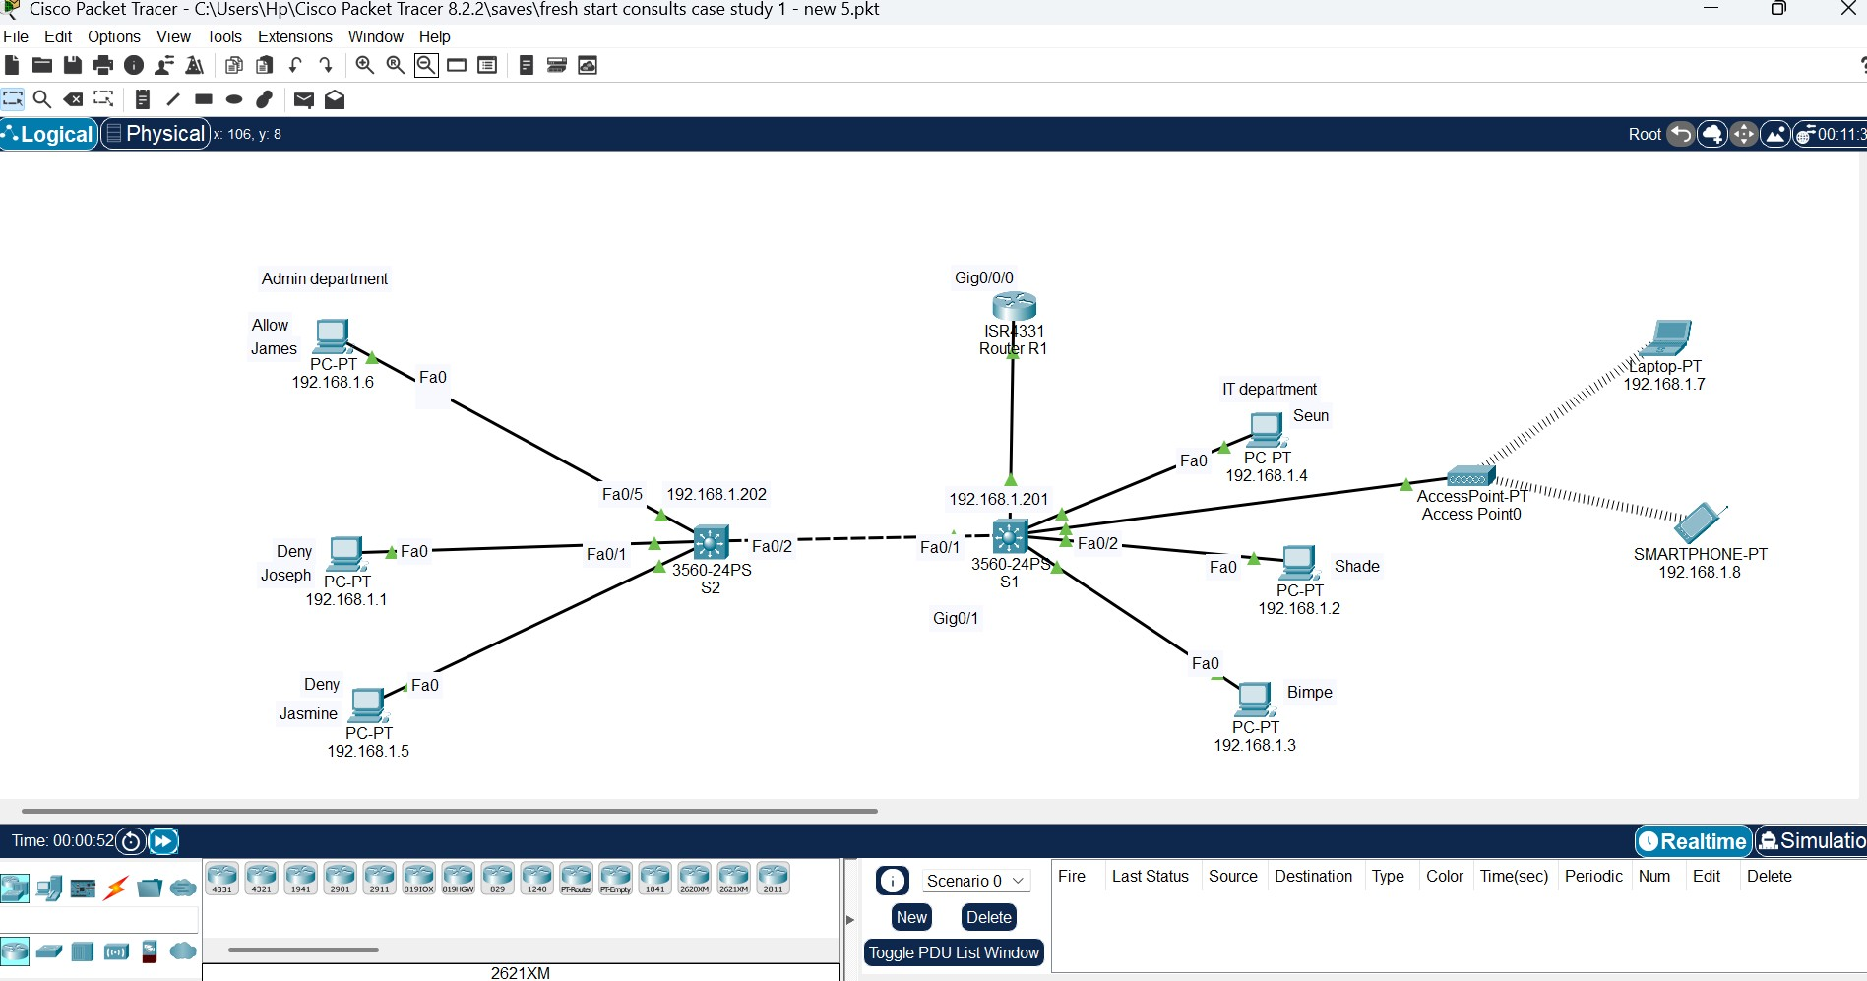
Removed home router with cable router

Slide 8
Connecting the router to the Layer 3 switch
Use copper straight through cable
Connect the switch to the router (Select Gigabite Ethernet 0/0
Router>en
Router (Config)# host R1 – to change name
R1 Conf t
R1 (Config)#int
R1(Config)#int
R1(Config-if)#ip address 192.168.1.254 255.255.255.0
R1(Config-if)#end
R1#ping 192.168.1.201 - (Ping switches to test)
Default gateway = 192.168.1.254

Slide 9
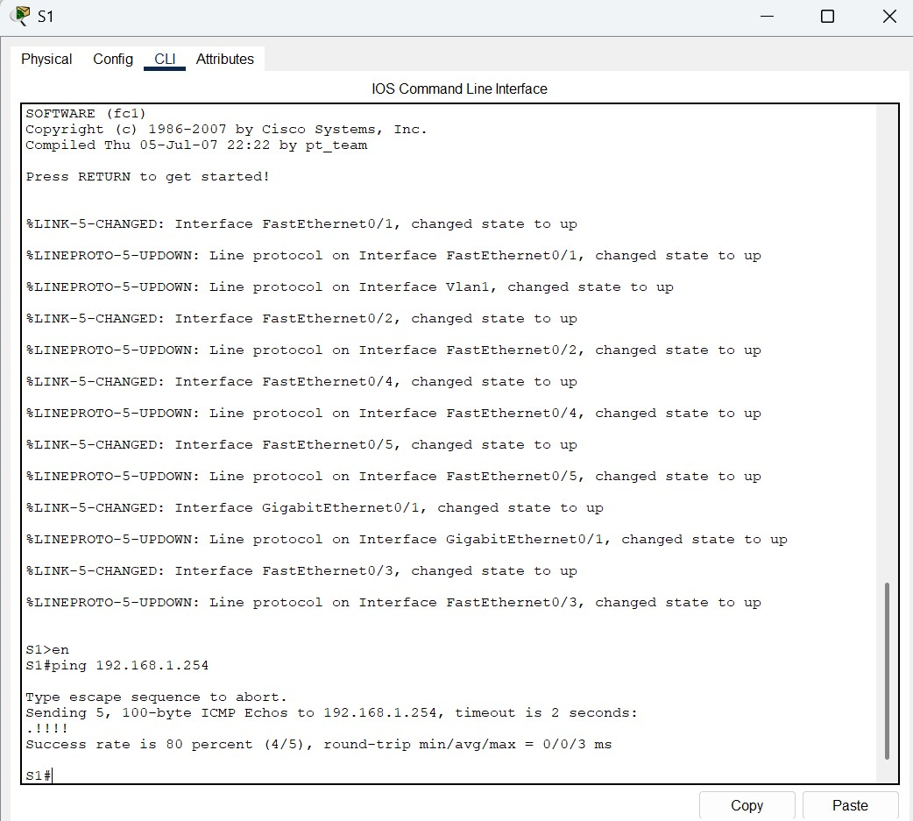
Test the connection by switch successfully pinging router

Slide 10
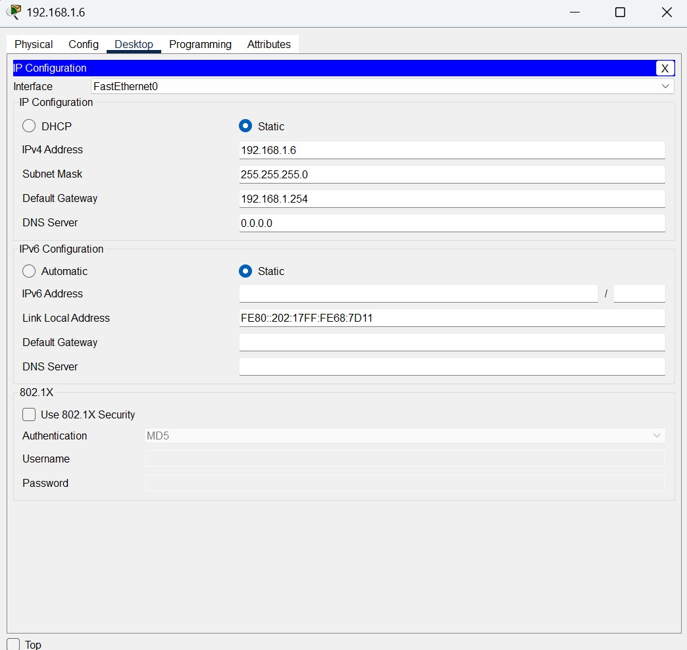
Configure IP address and default gateways on all PCs

Slide 11
Gateway 192.168.1.254 using wired router
Admin dept
James-Allow-192.168.1.6
Joseph-Deny-192.168.1.1
Jasmine Deny-192.168.1.5
IT Dept
Seun Allow -192.168.1.4
Shade deny-192.168.1.2
Bimpe allow-192.168.1.3
While using static protocol

Slide 12
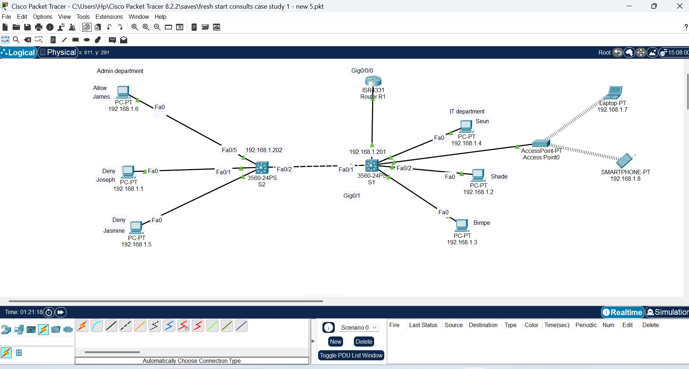
Network showing new IP addresses for PCs

Slide 13
3.Creating a scenario where one device is blocked from accessing the internet, and another is allowed; Configuring access control list 1 on multil user switch 2
To deny traffic from 192.168.1.1
switch>en
Switch#conf t
Switch(config)# ip access-list standard FILTER_ACL
Switch(config-std-nacl)#deny 192.168.1.1
Switch(config-std-nacl)#permit any
Switch (config-std-nacl)#int fa0/1
Switch (config-if) #ip access-group FILTEER_ACL in

Slide 14
To configure access control list2 on multil user switch 2
switch>en
Switch #confit
Switch(config) #ip access-list standard FILTER_ACL2
Switch(config-std-nac1)#deny 192.168.1.2
Switch(config-std-std-nac1)#permit any
Switch (Config-std-nac1)#exit
Switch(config)#interfac fa 0/1
Switch(config-if)#ip access-group FILTER_ACL2 in
Switch (config-if)#

Slide 15
Configuring ACL on the Router using CLI
Router>en
Router# conf t
Router (Config)#ip access-list standard SACL
Router(Config-std-nacl)#deny 192.168.1.5 0.0.0.255

Slide 16
4.Document the steps you took and explain the reasoning behind your firewall rules.
I have decided to deny the admin department from from accessing the network while allowing the IT department to access.
The reasoning behind my decision is based on the principle of least priviledge.
The operations of the admin department is limited to internal operational processes and less of logical or technical activities
This demonstrates that the admin department should be granted only the minimum level of access or permissions necessary to perform their required tasks, hence the reason for denying admin access

Slide 17
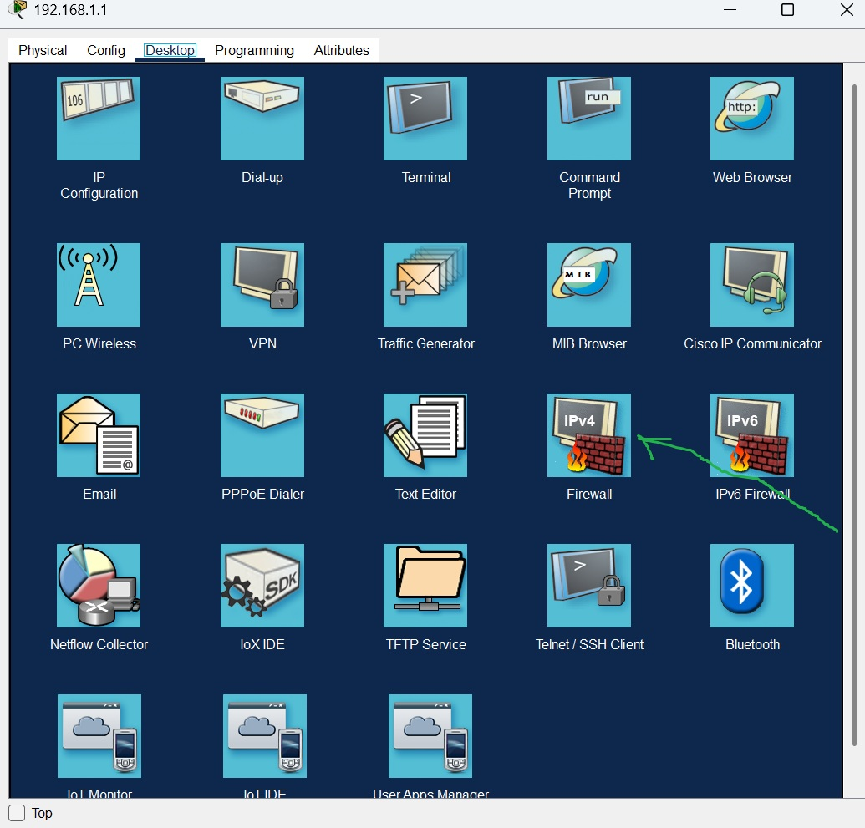
5.Test your firewall setup using ping and web simulations.

Slide 18
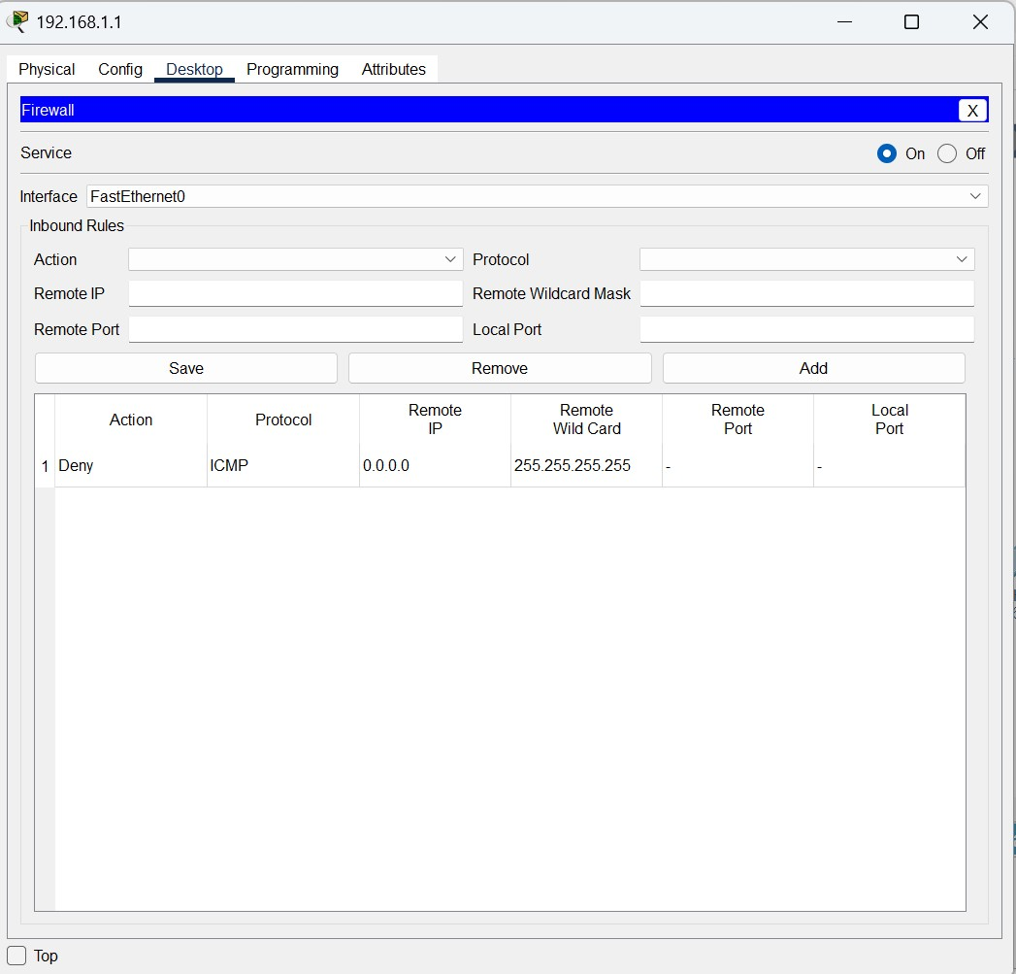
Configuring firewall on end device Joseph PC

Slide 19
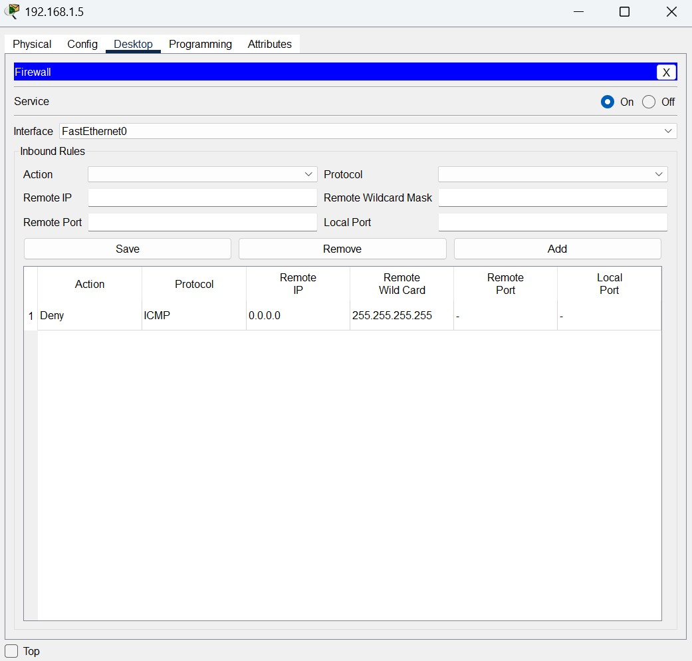
Configuring firewall on end device Jasmine PC

Slide 20
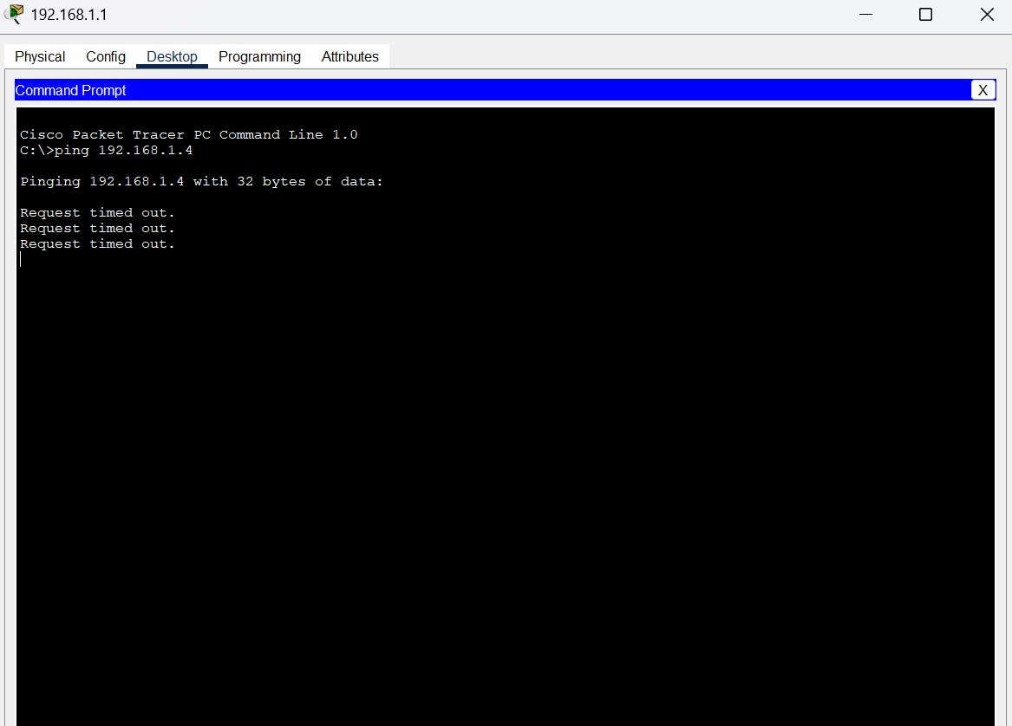
Pinging attempt showing blocked access on Joseph PC

Slide 21
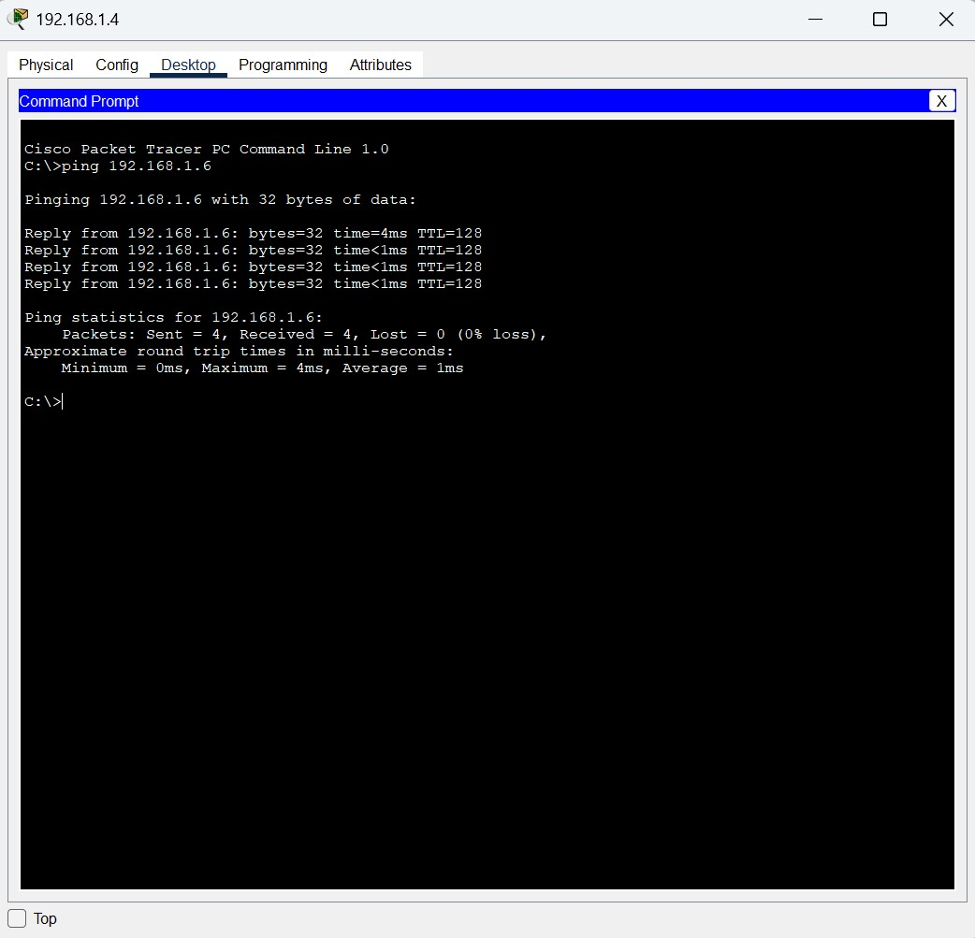
Pinging attempt showing blocked access on Seun PC

Slide 22
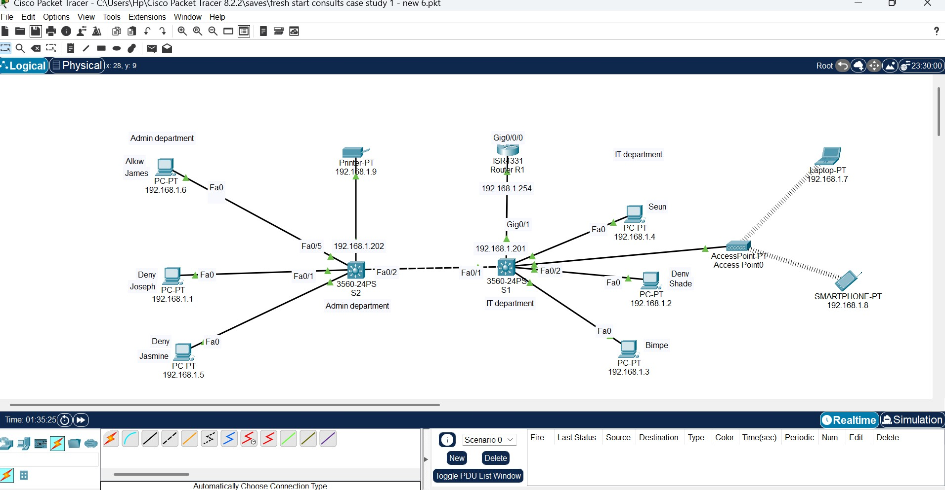
Network Scenerio showing end devices blocked while some are allowed

Slide 23
Useful commands
To check – ipconfig
Wr- to save my configuration
Switch#conft – to change to s1(Config)#
R1#sh ip int brief
R1# sh arp
Type end to complete configuration

Slide 24
THE END

